Slide 1

Analytics in a day
Cloud analytics in the age of self-service and data science
Notes:
TALK TRACK: Welcome Analytics In a Day! We’re excited to explain how analytics can transform your business – and more importantly, what concepts you must understand to do more with data. Let’s get started!

Slide 2
Agenda
Times are approximate and will be fluid with the class
Morning
9:00 – 10:00 The heart of analytics
10:00 – 11:00 Optimizing analytics with Azure Synapse Analytics
11:00 – 11:30 Data ingestion with Azure Data Factory
11:30 – 12:00 Insights for all with Power BI + Azure
Afternoon
1:00 –3:00 Lab 1: Building a Modern Data Warehouse
3:00 –4:30 Lab 2: Deep Dive on Azure Synapse Analytics
4:30 –5:00 How to get started
Notes:
TALK TRACK: In this workshop we will cover the breath of cloud data warehouse capabilities. We’ll teach you how to create an analytics pipeline that goes from data ingestion to business intelligence, empower self-service, and enable a truly data-driven culture in your business.
Later in the workshop we’ll walk you through hands-on training, to get started on your own cloud analytics journey.

Slide 3
The heart of analytics
Notes:
TALK TRACK: Welcome Analytics In a Day! We’re excited to explain how analytics can transform your business – and more importantly, what concepts you must understand to do more with data. Let’s get started!

Slide 4
Section 1 Data businesses need data warehouses
Notes:
TALK TRACK: This presentation will be organized into a number of different sections. We’ll start by first talking about how a data warehouse is fundamental to actually get the most out of your data.

Slide 5
Is the data warehouse still relevant?
What’s changed since 1988?
Commerce and technology
A 30-year-old architecture, still going strong
The data warehouse itself
Notes:
TALK TRACK: We all know that the world of technology moves fast. New products come to market at alarming speeds, and there are more and more sophisticated ways to capture and manage the ever-increasing amount and variety of data. So you might think it’s surprising to hear the data warehouse is as relevant today as it was in its origins 30 years ago.
Yes, this is true, but it’s only the case because the data warehouse has modernized over time and is a distant relative of the DW architecture from 1988.

Slide 6

Today, all businesses are data businesses
Data is the lifeblood of modern work
Data makes business possible
Data is crucial to businesses of all sizes
Securing data is mandatory
Notes:
TALK TRACK: Let’s now talk about how the world of data has changed.
First, all businesses are data businesses. From the corner store with online accounting and stock-keeping to the largest internet retailers, we all run on data.
And an enterprise that does not manage, govern and secure its data will simply not survive in the new economy.

Slide 7

All data businesses need to be analytic businesses
Without analytics data is a cost center, not a resource
Businesses need to “know thyself”
Workers are empowered with intelligent insights
Augmented intelligence sees patterns we cannot
Notes:
TALK TRACK: It’s one thing to gather and manage data, but it’s another to make decisions based on it. This is where analytics comes in. Without analytics, data doesn’t serve any role.
Dashboards and reports support awareness of the current state of the business.
BI and visualization strengthen the role of knowledge workers with informed insight.
Augmented intelligence can discover information and patterns that even experts may overlook.

Slide 8

Analytic businesses need to evolve data science
Every business has opportunities to make analytics faster, easier, and more insightful
Data science empowers us to go farther
Businesses need scalable analytics
AI/ML creates smarter organizations
Notes:
TALK TRACK: Analytics are important, but it’s increasingly evident that not all analytics are equal. Businesses can do more and more complex analytics for better, faster, and more automated insights.
- Data science enables automated insight with a depth and scale beyond the abilities of human analysts.
- Even small businesses today need scalable analytics of social media, digital interactions and markets.
- Increasingly, machine learning and artificial intelligence drive autonomous processes and decisions for smart organizations.

Slide 9

The cloud data warehouse in the data-driven business
LOB sources
Azure Data Factory
Business services
Azure Synapse Analytics
Logs and streams (unstructured)
Azure Databricks
Power BI
Media (unstructured)
Files (unstructured)
Azure Data Lake Storage
Notes:
TALK TRACK: Now let’s describe how data warehouse serves a business through a simple architectural diagram.
- The modern data warehouse sits at the heart of enterprise analytics, as a source of sanctioned data, as a system of record and as a hub, serving models for reporting, business intelligence and data science

Slide 10
Data sources for analytics
LOB sources
Azure Data Factory
Business services
Azure Synapse Analytics
Logs and streams (unstructured)
Azure Databricks
Power BI
Media (unstructured)
Files (unstructured)
Azure Data Lake Storage
Notes:
TALK TRACK:
As an enterprise system of record for business processes, the data warehouse is mostly built over line-of-business data sources.
Whether that data is unstructured, structured, or semi-structured, the modern data warehouse can handle it.
Other, more volatile, sources are often used for data science, or for ad-hoc analysis.

Slide 11
Data ingestion
LOB sources
Azure Data Factory
Business services
Azure Synapse Analytics
Logs and streams (unstructured)
Azure Databricks
Power BI
Media (unstructured)
Files (unstructured)
Azure Data Lake Storage
Notes:
TALK TRACK:
- For the data warehouse, Azure Data Factory schedules and orchestrates data transformations and bulk loads. Meanwhile, Azure Databricks performs transformations specifically for data science and also builds and executes models. Scores from these models may be loaded into the data warehouse, to integrate these insights with enterprise applications and reports.

Slide 12
Data storage & serving
LOB sources
Azure Data Factory
Business services
Azure Synapse Analytics
Logs and streams (unstructured)
Azure Databricks
Power BI
Media (unstructured)
Files (unstructured)
Azure Data Lake Storage
Notes:
TALK TRACK:
- Azure Data Lake may be used to store raw data in high volume for later use, along with staging transformed data from Azure Databricks.
- Azure Synapse Analytics provides high-performance, highly-scalable data storage for enterprise models, with outstanding security, governance and manageability.

Slide 13
Data consumption
LOB sources
Azure Data Factory
Business services
Azure Synapse Analytics
Logs and streams (unstructured)
Azure Databricks
Power BI
Media (unstructured)
Files (unstructured)
Azure Data Lake Storage
Notes:
TALK TRACK:
Power BI consumes sanctioned enterprise data from the data warehouse for reporting and analytics, but may also use data from the data lake for ad-hoc analysis and integrating with data science
Many business services, including line-of-business applications, consume data from the data warehouse as an authoritative, governed, source of enterprise knowledge.

Slide 14
Section 2 BI and DW come together
Notes:
TALK TRACK: We’ve talked about key elements to a modern data warehouse, but why is it important for business intelligence and what do you need to know to derive intelligence from data?

Slide 15

The new economy thrives on data literacy
Communicating with data is a critical skill in the new economy
Sources and tools are evolving, and expanding capabilities
Data-driven processes are essential
Data literacy is a shared organizational practice
Notes:
TALK TRACK: Understanding your data is only one piece of the puzzle in today’s world. Being able to articulate your data’s insights to your organization is where real value is found.
- Increasingly, decision makers reach beyond traditional reports and dashboards to engage with new sources and tools: big data, machine learning and even AI.
- In this environment, being able to define and work with data-driven processes is essential.
- Data literacy has become more than just a useful individual skill, it is a shared organizational practice.

Slide 16

Users and IT must come together in the new enterprise
Get over the IT / business divide
Business users expect tools and services that work the way they work
IT no longer controls or constrains every aspect of the new enterprise
IT and business both need self-service analytics tools
Notes:
TALK TRACK: When shared data literacy can be combined with self-service tools, individuals become empowered, teams become tighter, and organizations become stronger.
- Business users today are tech-smart and expect tools and services that work the way they work.
- Just like Bring-Your-Own-Device, users expect to use self-service analytics tools to build their own dashboards and visualizations.
- In an enterprise with self-service analytics, IT cannot expect to control or constrain every aspect of knowledge work. But they can provision data and services, while monitoring usage and security.

Slide 17

Governance and self-service enhance decision-making
Governance is not about making the right decisions, it is about making decisions the right way
IT’s new role is to support effective best practices
Business users want to consume curated data
Platforms allow for self-service analytics
Notes:
TALK TRACK: Self-service business intelligence puts data governance in the hands of all users.
- IT’s new role is to provide well-managed tools and services to support effective best practices, even if they cannot guarantee the results.
- Services include curated data for business users to consume for BI and analytics.
- Platforms include data warehouses and data lakes with data science tools and self-service analytics.

Slide 18
The importance of data models
Enterprise models
Built and maintained by IT architects
Consolidated data from many systems
Centralized as an authoritative source for reporting and analysis
Azure Synapse Analytics
BI models
Built and maintained by business users or BI developers
Use enterprise models, departmental data, and external sources
Focused on a single subject area, but often widely shared
Power BI
Machine Learning models
Built and maintained by data scientists
Mostly developed from raw sources in the data lake
Often experimental, needing a data engineer for production use
Azure Databricks
Notes:
TALK TRACK: New business capabilities are enabled not by data alone, but by data models which describe concepts, relationships, rules and standards.
Enterprise models consolidate data from many systems and act as a centralized source for analysis
Business intelligence models use enterprise models but focus on a single subject area in more detail
And ML models are developed from raw sources and are often experimental and require specialty skills for production use.

Slide 19
Enterprise models in the self-service environment
Consistency Some business processes can be built once and shared as a corporate standard
Governance Certain data sets need complex security and privacy controls
Efficiency No need to repeat design, preparing, and loading or securing
If business users are tech-smart and data literate, why do they need enterprise models?
Azure Data Factory
Azure Synapse Analytics
Line-of-Business sources
Enterprise models
Power BI
Notes:
TALK TRACK: Now we’ll revisit the different data models and talk through why they still matter if businesses are tech-smart and data literate:
For consistency. There are numerous business processes which should be built once and shared as a corporate standard, such as defining product catalogs, staff hierarchies, and client organization IDs.
For governance. Certain data sets, such as customer information or financials, need security and privacy controls, which may be complex and dynamic.
For efficiency. If models already exist in the data warehouse, there is no need to repeat the work of design, preparing and loading data, or securing the model.

Slide 20
BI models in the enterprise environment
Flexibility Some data sets are temporary, external, or ad-hoc don’t need to be consolidated
Efficiency Tech-smart business users have fresh and innovative ideas they need to explore with agility
If enterprise models are so important, why do users need self-service BI models?
Azure Data Factory
Azure Synapse Analytics
Line-of-Business sources
Enterprise models
Power BI
BI models
Ad-hoc, departmental and external sources
Notes:
TALK TRACK: Enterprise models are clearly important, but you can’t get by just with them. Let’s now talk about how business intelligence models play a role. Why do users need them:
For flexibility. There are numerous data sets which are temporary, or external, or ad-hoc and unlikely to be consolidated in the data warehouse. In these cases, business intelligence models are useful, for example for planning and monitoring a short term campaign, or modelling a budget for a departmental project.
For efficiency. Tech-smart business users have fresh and innovative ideas they need to explore with agility. The process of building centralized models to support all these initiatives is too cumbersome. But successful and widely adopted business intelligence models may be re-factored into the data warehouse for future enterprise use.

Slide 21
Data science models in the enterprise environment
Integrating results with enterprise models Making the results of data science easily available for business functions
Serving enterprise data for data scientists Helps ensure consistency across diverse analyses
What is the role of the data warehouse with data science?
Azure Synapse Analytics
Enterprise models
Power BI
Azure Databricks
Data science results
Notes:
TALK TRACK: Enterprise models are clearly important, but you can’t get by just with them. Let’s now talk about how business intelligence models play a role. Why do users need them:
For flexibility. There are numerous data sets which are temporary, or external, or ad-hoc and unlikely to be consolidated in the data warehouse. In these cases, business intelligence models are useful, for example for planning and monitoring a short term campaign, or modelling a budget for a departmental project.
For efficiency. Tech-smart business users have fresh and innovative ideas they need to explore with agility. The process of building centralized models to support all these initiatives is too cumbersome. But successful and widely adopted business intelligence models may be re-factored into the data warehouse for future enterprise use.

Slide 22
Section 3 The cloud for modern data warehouse
Notes:
TALK TRACK: We’ve talked about key elements to a modern data warehouse, but why should it be in the cloud?

Slide 23

Modern businesses succeed in the cloud
The cloud is the default environment for new technology initiatives
Applications are increasingly cloud-native
Collaboration platforms and file-sharing are transforming
Hybrid businesses are replacing on-premises data management
Notes:
TALK TRACK: The Cloud enables projects that are easier to start and easier to scale.
- ERP, CRM, and operational applications are increasingly cloud-native.
- Collaboration platforms and file-sharing have been transformed by cloud’s flexibility and scale.
- Even when governance requires on-premises data management, modern business tends to be hybrid.

Slide 24

Cloud security offers a new level of protection
Businesses benefit from built-in security found only in the cloud
Data warehouses store their content under lock and key
Cloud security is proactive in detecting threats
Cloud security offers vital resilience and availability
Notes:
TALK TRACK: Cloud-based data warehouse services provide layers of protection and built-in security and compliance tools.
- In the data warehouse itself you expect encryption, sensitive data classification, row and column based security.
- But you also need services such as threat detection and monitoring, virtual networks and integrated ID management.
- Resilience and availability are not just good objectives, but vital security features for global, always-on services. Geo-replication, point in time restore and the highest availability come with the cloud.

Slide 25

The modern data warehouse is an economic breakthrough
Price, performance, and agility
High infrastructure costs are avoided with cloud-based data warehouses
Iterating designs and handling diverse data becomes more efficient
Elastic scaling makes world-class performance available to all users
Notes:
TALK TRACK: Cloud-based data warehouses eliminate the need for large capex investments.
- Deploying your data warehouse in the cloud is faster, easier and more flexible than a traditional data solution, without the high hardware and infrastructure costs.
- Iterating designs and handling diverse data is far more efficient than for a on-premises solution.
- World-class performance is available to all users as Azure Synapse Analytics optimizes analytic and operational workloads with elastic scaling.

Slide 26

The modern data warehouse is the hub for all data models
Structured, unstructured, and streaming data integrated in a single, scalable, environment
Workloads can be stored, managed and provisioned together
Visualization and data science tools empower enterprise-wide insights
No need to juggle processing schedules
Notes:
TALK TRACK: As the volume and variety of data continually expands modern, cloud-based data warehouses can serve as the home for all data.
- Enterprise models, BI sandboxes and predictions can all be stored, managed and provisioned together.
- Enterprise ETL or self-service data-wrangling: both are efficiently handled with no need to juggle processing schedules.
- Deliver enterprise-wide reports and enable ad-hoc data discovery with an endless variety of visualization or data science tools.

Slide 27
Power BI and Azure Synapse Analytics
Bring together the market-leading BI platform and the industry-leading data warehouse engine in Azure Synapse
Power BI can analyze and visualize massive volumes of data
Azure Synapse Analytics provides a scalable platform to enable real-time BI
Notes:
TALK TRACK: Power BI is the market leading platform, and offers incredible capabilities on Azure Synapse Analytics – the highest performance cloud DW.
EDW query performance is no longer a matter just for IT. Today’s leading tools, like Power BI, can analyze and visualize large volumes of data. Self-service users’ queries are often exploratory and ad-hoc, not scheduled.
Power BI users wishing to analyze real-time or unstructured data need a scalable platform which can be queried easily with familiar syntax and connectivity.

Slide 28
Section 4 Data warehouses are still in style
Notes:
TALK TRACK: Now we’ll wrap up this overview session with some final thoughts…

Slide 29
Azure Synapse Analytics lies at the heart of business and BI
LOB sources
Azure Data Factory
Business services
Logs and streams (unstructured)
Azure Synapse Analytics
Azure Databricks
Power BI
Media (unstructured)
Files (unstructured)
Azure Data Lake Storage
Notes:
TALK TRACK: As we have seen, the modern data warehouse serves many enterprise data functions. It can consolidate business data, integrate machine learning into the mainstream business and provision vital resources for governed self-service.

Slide 30
The data warehouse still has its mojo and it’s only getting better
Azure Synapse Analytics
Power BI
Notes:
TALK TRACK:
It’s a mistake to think that new technologies such as big data, self-service BI and data science have somehow superseded established technologies such as the data warehouse.
In fact, Microsoft’s Azure Synapse Analytics, a modern data warehouse with advanced architecture, security and manageability, is more relevant than ever.
This is especially true when provisioning data for self-service, as regulations world-wide demand greater governance, even while business demands greater autonomy.

Slide 31
Azure Synapse Analytics Limitless analytics service with unmatched time to insight

Slide 32
Introducing Azure Synapse Analytics
A limitless analytics service with unmatched time to insight, that delivers insights from all your data, across data warehouses and big data analytics systems, with blazing speed
Simply put, Azure Synapse is Azure SQL Data Warehouse evolved
We have taken the same industry leading data warehouse and elevated it to a whole new level of performance and capabilities
Notes:
Same industry leading data warehouse: https://azure.microsoft.com/en-ca/blog/analytics-in-azure-is-up-to-14x-faster-and-costs-94-less-than-other-cloud-providers-why-go-anywhere-else/

Slide 33




Organizations that fully harness their data outperform
AI apps & agents
Data consolidation using Azure Synapse Analytics
Migration to the cloud for efficient business operations
Using Azure Synapse Analytics for predictive analytics
Notes:
Lets look at some of our customers who have taken advantage of Azure analytics and reaped benefit.
Each of these stories highlights an unique benefit that they realized.
ABI’s case highlights the performance enhancements they experienced
Newell noticed significant cost savings
Maritz took advantage of the ability to ingest high volumes of data.

Slide 34
Cloud-scale analytics
Modern data warehousing
Advanced analytics
Real-time analytics
"We want to analyze data coming from multiple sources and in varied formats"
"We want to leverage the analytics platform for advanced fraud detection"
“We’re trying to get insights from our devices in real-time”
At the core of all use cases is..
Azure Synapse Analytics
Notes:
All the customers we spoke about in the slides before used cloud scale analytics to achieve their goals.
For example, we have customers who leverage our Modern Data Warehouse track to ingest and analyze varied data sources or customers performing fraud detection analysis.
While we talk of all these use cases and how customers are benefitting from them, notice at the core of all these use cases is the Azure Synapse Analytics.

Slide 35


Azure Analytics
Ingest
Prep
Model & Serve
Transform
Query
On-premises data
Cloud data
Azure Data Factory
Azure Databricks
Azure Synapse Analytics
Devices data
Power BI
Store
SaaS data
Store
Azure Data Lake Storage

Slide 36


Azure Synapse Analytics
Limitless analytics service with unmatched time to insight
Ingest
Transform
Query
2
PREVIEW
Unified experience
On-premises data
Synapse Studio
Integration
Management
Monitoring
Security
Cloud data
Analytics Runtimes
Power BI
SQL
GA
PREVIEW
SaaS data
Store
Azure Data Lake Storage
Notes:
Azure Synapse is a limitless analytics service, that brings together enterprise data warehousing and Big Data analytics. It gives you the freedom to query data on your terms, using either serverless on-demand or provisioned resources—at scale. Azure Synapse brings these two worlds together with a unified experience to ingest, prepare, manage, and serve data for immediate BI and machine learning needs.
We have taken the same industry leading data warehouse to a whole new level of performance and capabilities. Businesses can continue running their existing data warehouse workloads in production today with Azure Synapse and will automatically benefit from the new capabilities which are in preview. Businesses can put their data to work much more quickly, productively, and securely, pulling together insights from all data sources, data warehouses, and big data analytics systems

Slide 37

Innovations in Azure Synapse
Multiple clusters over shared data
Online scaling
Workload aware query scheduling
Single Access and Security for Data Warehouse and Data Lake workloads
Spark + SQL integrated runtime
Cluster + Serverless
Notes:
Multiple compute pools over common shared data provides workload isolation and predictable performance for different teams within an enterprise. Transactional consistency of data is guaranteed and no silo’s are created.
Online scaling provides Synapse to adjust compute resources allocated to a workload in real-time without any interruption to running queries
The new cloud scale distributed query processor dynamically assigns resources to maximize query throughput and automatically rebalances compute as workload characteristics change
One experience for both data warehouse and data lake, manage, monitored, and secured through a single platform experience
One-click choice of SQL or Spark runtime within the single service enables any analytics of all data in one place
Cluster and Serverless form factors provides flexible compute allocation to suit the analytics workload

Slide 38
Customer Journey
Current “SQL DW” customers
(now Azure Synapse Analytics customers as of Nov. 4th)
Continue to build modern data warehouse with Azure, using Azure Synapse for your enterprise data warehouse
Automatically enjoy newly announced Azure Synapse preview features when they become generally available
New adopters of Azure Synapse Analytics for enterprise data warehousing
(Starting Nov. 4th and beyond)
No migration necessary
Seamless journey

Slide 39

Azure Synapse Analytics
Limitless Scale
Powerful Insights
Unified Experience
Unmatched Security
Provisioned Data Warehouse
On-demand Query as a Service
GENERALLY AVAILABLE
PREVIEW

Slide 40
Limitless scale | GA | Preview
Provisioned compute (data warehouse)
Materialized views
Workload importance
Workload isolation
On-demand query
Powerful insights
Power BI integration
Azure Machine Learning integration
Data lake exploration
Streaming analytics (data warehouse)
Apache Spark integration
Unified experience
Hybrid data ingestion
Azure Synapse studio
Unmatched security
Column- and row-level security
Dynamic data masking
Private endpoints
Azure Synapse Analytics features

Slide 41
The cloud data warehouse in the data-driven business
LOB sources
Azure Data Factory
Business services
Azure Synapse Analytics
Logs and streams (unstructured)
Azure Databricks
Power BI
Media (unstructured)
Files (unstructured)
Azure Data Lake Storage
Notes:
TALK TRACK: Now let’s describe how data warehouse serves a business through a simple architectural diagram.
- The modern data warehouse sits at the heart of enterprise analytics, as a source of sanctioned data, as a system of record and as a hub, serving models for reporting, business intelligence and data science

Slide 42
Best-in-class price per performance
Leader in price per performance
25% less expensive than Redshift
94% less expensive than BigQuery
Price-performance is calculated by GigaOm as the TPC-H metric of cost of ownership divided by composite query.
Results based on GigaOm’s TPC-H results, published in January 2019
Notes:
We are not only fast, but we are fast and inexpensive. GigaOm recently benchmarked all the top cloud data warehouse providers and found that for every unit of performance, our customers pay $0.75 and $0.06, while customers of our competitors pay $1.00.

Slide 43


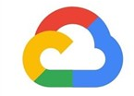

Best-in-class price per performance
Price-performance @ 30TB
Lower is Better
$
5
6
$
4
6
0
0
$
5
5
0
$152
$140
$110
$120
$103
$100
$80
$
6
0
$
5
4
$
5
$
1
$
4
8
4
$
7
5
0
$
4
$
0
4
0
$
3
$
3
3
0
$2
0
$
1
0
$
0
C
C
C
y
N
N
N
0
0
0
r
e
0
0
0
00
00
u
1
3
6
000
2x-Large
3x-Large
4x-Large
Q
-
-
-
5
5
g
e
e
e
W
1
3
g
g
g
W
W
Bi
r
r
r
D
D
la
la
la
D
x
x
x
8
8
8
.
.
.
c2
c2
c2
d
d
d
Azure Synapse Analytics
Snowflake
Google BigQuery
Amazon Redshift
Price-performance is calculated by GigaOm as the TPC-H metric of cost of ownership divided by composite query.
Results based on GigaOm’s TPC-H results, published in January 2019
Notes:
Extending the data point from last time, this graph clearly shows that we lead at any level of compute.

Slide 44
Best-in-class price per performance
Price-performance @ 30TB
Lower is Better
$1310
$600
$570
$500
$400
$309
$300
$286
$206
$200
$153
$100
$0
Azure Synapse Analytics
Amazon Redshift
Snowflake Standard
Snowflake Standard
Google BigQuery
Flat Rate
Google BigQuery
Flat Rate
Price-performance is calculated by GigaOm as the TPC-H metric of cost of ownership divided by composite query.
Results based on GigaOm’s TPC-DS results, published in February 2019
Notes:
We continue our leadership in the analytics space, as seen in the TPC-DS results published by GigaOm in Feb 2019.

Slide 45
Most secure data warehouse in the cloud
Data Protection
Access Control
Authentication
Network Security
Threat Protection
Customer Data
Multiple levels of security between the user and the data warehouse
...at no additional cost
Notes:
We have multiple levels of security between the user and the data warehouse. This keeps your data safe and secure. While some of our competition charges for different levels of security, we don’t! We offer one comprehensive security plan, all at no additional cost. Lets dive a bit deeper into these features and see how they keep your data safe and secure.
With threat protection provides, get notified of potential threats​ with auditing tools and​ anomalous activity alerting​
Leverage network security to ensure that all the data is within the secure environment
Centrally manage and control identity and user access ​with Azure Active Directory
Row and column level security provides granular access control
You data is protected at rest, in transit and in in use.

Slide 46
Category | Feature | Synapse Analytics
Data Protection | Data In Transit | Yes
 | Data encryption at rest (Service & User Managed Keys) | Yes
 | Data Discovery and Classification | Yes
Access Control | Native Row Level Security | Yes
 | Table and View Security (GRANT / DENY) | Yes
 | Column Level Security | Yes
 | Dynamic Data Masking | Yes
Authentication | SQL Authentication | Yes
 | Native Azure Active Directory | Yes
 | Integrated Security | Yes
 | Multi-Factor Authentication | Yes
Network Security | Virtual Network (VNET) | Yes
 | SQL Firewall (server) | Yes
 | Integration with ExpressRoute | Yes
Threat Protection | SQL Threat Detection | Yes
 | SQL Auditing | Yes
 | Vulnerability Assessment | Yes
Access control for complete security
Notes:
Azure Synapse Analytics provides fine-grained access control for your platform.
With the combination of native row-level and column-level security, you can ensure that data is secure for each user
Dynamic Data Masking enables administrators and data developers to control access to their company's data, allowing sensitive data to be safe and restricted. It prevents unauthorized access to private data by obscuring the data on-the-fly
Because your data warehouse stores your most important and valuable business data, you should never compromise on security features. Azure Synapse Analytics is the industry-leader in security.

Slide 47
Prioritize your workloads using workload management
Maximize your ROI through granular workload control
Dynamically allocate your data warehouse resources using classifiers
Prioritize your most essential tasks with workload importance
Notes:
Workload management helps you control and prioritize your workloads.
Use this feature to have granular control on how your workloads are being run or how you allocate resources to the different users, based on the importance of their queries.

Slide 48




What if you want to prioritize the workloads that get access to resources?
Scheduler without importance
CEO
CEO
CEO
1
2
3
9
4
5
10
6
7
8
10
9
11
12
10
11
12
Running
Queued
Queued
Queued
By default, workloads are run on a first-in first out basis.
Notes:
Let’s consider the following case, where the CEO wants to run a quick analysis on revenue. He or she is stuck behind three workloads in the queue and will have to wait for their turn. Clearly, a frustrating situation, given that the CEO needs the results immediately.
This is not an uncommon situation and is encountered by several data driven organizations. So how do we solve this?

Slide 49

With workload importance, prioritized workloads take precedence
CREATE WORKLOAD CLASSIFIER classifier_name
WITH
(
WORKLOAD_GROUP = 'name’ ,
MEMBERNAME = 'security_account' [ [ , ]
IMPORTANCE = { LOW | BELOW_NORMAL | NORMAL (default) | ABOVE_NORMAL | HIGH }])
Scheduler With Importance Turned On
CEO
CEO
1
2
3
12
4
5
6
7
8
9
10
11
12
Normal
Low
Normal
High
Running
Queued
Queued
Notes:
Introduce workload management
With workload management, you can define the importance of a workload as low, normal or high.
Let us now consider the same situation but with the CEO's importance set at high, that workload takes predominance over others in the queue.

Slide 50
Scheduler Without Importance
Workload Management Workload Importance
CEO
CEO
CEO
1
2
3
9
4
5
10
6
7
8
10
9
11
12
10
11
12
Running
Queued
Queued
Queued
By default, workloads are run on a first-in first out basis.
Notes:
Charles

Slide 51




Intra Cluster Workload Isolation
(Scale In)
Sales
60%
Workload isolation takes management to the next level
Marketing
40%
Data
Warehouse
Notes:
Predictable cost
Online elasticity
Efficient for unpredictable workloads
No cache eviction for scaling

Slide 52
See more by scaling to petabytes
CREATE MATERIALZIED VIEW vw_ProductSales
WITH (DISTRIBUTION = HASH(ProductKey))
AS
SELECT
ProductName
ProductKey,
SUM(Amount) AS TotalSales
FROM
FactSales fs
INNER JOIN DimProduct dp ON fs.prodkey = dp.prodkey
GROUP BY
ProductName,
ProductKey
Notes:
Materialized views give you a new level of insight, by adding transactional consistency to data modification and automatic Query Optimizer matching.

Slide 53

See more by scaling to petabytes
CREATE MATERIALZIED VIEW mvw_ProductSales
WITH (DISTRIBUTION = HASH(ProductKey))
AS
SELECT
ProductName
ProductKey,
SUM(Amount) AS TotalSales
FROM
FactSales fs
INNER JOIN DimProduct dp
ON fs.prodkey = dp.prodkey
GROUP BY
ProductName,
ProductKey
FactSales Table
10B Records
DimProduct Table
1,000 Records
Materialized View (1000 Records)
ProductName | ProductKey | TotalSales
Product A | 5453 | 784,943.00
Product B | 763 | 48,723.00
… | … | …
SELECT
<COLUMNS>
FROM FactSales fs
INNER JOIN
(
SELECT
ProductName
ProductKey,
SUM(Amount) AS TotalSales
FROM
FactSales fs
INNER JOIN DimProduct dp
GROUP BY
ProductName,
ProductKey ) ps
INNER JOIN FactInventory
GROUP BY …
FactInventory Table
mvw_ProductSales
1,000 Records

Slide 54

Build confidence in your data with result set cache
SELECT
ProductName
ProductKey,
SUM(Amount) AS TotalSales
FROM
Fact Sales
INNER JOIN DimProduct
GROUP BY
ProductName,
ProductKey
Execution 2
Cache Hit
Resultset
Cache
~.2 seconds
Execution 1
Cache Miss
Regular Execution
Data
Warehouse
Notes:
Result set Cache Automatic query matching Implicit creating from query activity Resilient to cluster elasticity

Slide 55
Empower more users per data warehouse
Leverage up to 128 concurrent slots, simultaneously, on a single data warehouse
Number of simultaneous workloads increases with data warehouse capacity
Utilize preset functions to allocate resources that need them the most
Notes:
Concurrency is an important ask for many of our customers. In a nutshell, it indicated the number of simultaneous users or queries that can be run at the same time.
Azure Synapse Analytics leads the industry in concurrency, with up to 128 concurrent queries for a single data warehouse.
Concurrency increased with an increase in compute power. Adding more compute power would let more users access the data warehouse.
There are preset functions called resource classes that users can leverage to set concurrency limits thereby diverting resources to the more important workloads.

Slide 56
Use preferred tools for Azure Synapse Analytics development
Familiar SQL experience with SQL Server Management Studio
Track, apply, and deploy changes with Azure DevOps in Visual Studio
Cross platform functionality with Azure Data Studio and VSCode
Notes:
Azure Synapse Analytics has deep and tight integration with SQL Server Management Studio​, SQL Server Data Tools in Visual Studio​, Azure Data Studio​, Visual Studio Code​, Command line and PowerShell tools​.

Slide 57
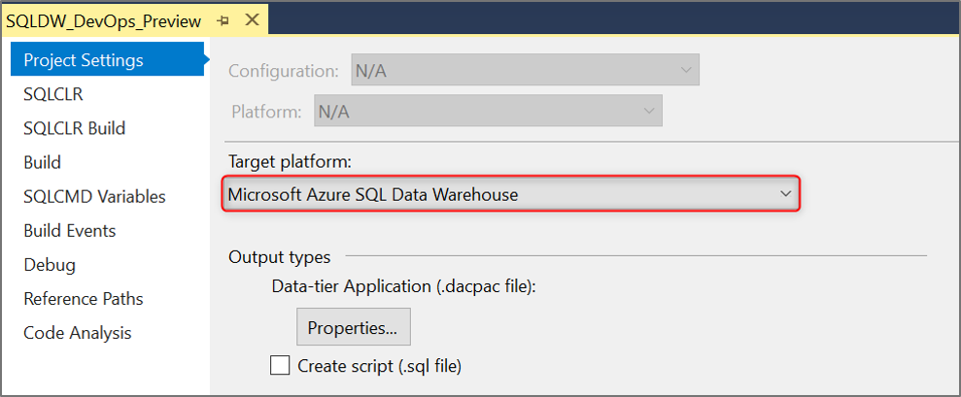
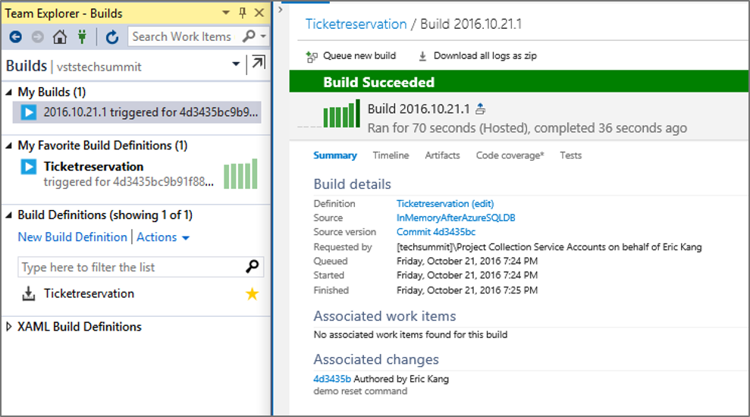
Use preferred tools for Azure Synapse Analytics development
Notes:
SQL has a robust ALM for data warehouse deployment, ensuring low risk of breaking changes and inefficiencies in team development.
Furthermore Visual Studio provides comprehensive Load testing framework, and can efficiently orchestrate end-to-end Integration Testing
Azure Synapse Analytics supports version control, unit testing, app development lifecycle. Unique to Synapse Analytics, as competitors don’t offer this.

Slide 58
Data ingestion with Azure Data Factory Simplify ETL at scale

Slide 59





Organizations that fully harness their data outperform
AI apps & agents
Transforms data from multiple sources to provide feature rich experiences for clients
Focuses on the data itself rather than the logistics of ingesting
Approaching disparate data sources with automated and scalable processes
Notes:
Milliman
“Integrate takes a holistic, forward-looking approach to the automation and governance of actuarial modeling and reporting. Powered by Microsoft Azure, Integrate reimagines the relationship between people, processes, and technology and unlocks the full potential of actuarial staff. It takes advantage of Azure for complex computational tasks, and leverages services such as Azure Data Factory and Azure HDInsight to automate extract, transform, and load (ETL) processes and crunch big data.”
https://customers.microsoft.com/en-us/story/732463-top-actuarial-firm-transforms-the-insurance-industry-w
LUMEDX
“Oakland, California–based LUMEDX provides cardiovascular information systems that consolidate the images and data cardiologists use to plan patient care. Until recently, healthcare providers could spend months analyzing data, making it difficult to relate outcomes to variables in the system. Now LUMEDX uses Microsoft Azure Data Factory to produce insights in a fraction of that time. The quality-enhancing data could be just the prescription healthcare organizations need to provide better care at a lower cost.”
https://customers.microsoft.com/en-us/story/lumedx-partner-professional-services-azure-data-factory
Concerta
“London-based data analytics consultancy Concentra Analytics creates software as a service (SaaS) data solutions that its enterprise clients use to make transformative, data-driven decisions. While developing a set of robust standards for its project-based development teams, leaders from the firm’s Business Intelligence practice created a platform based on Microsoft Azure that automatically generates data warehouses and extract, transform, and load (ETL) packages to customer specs, drastically reducing development time and cost and delivering deeper, data-based insights.”
https://customers.microsoft.com/en-us/story/concentra-partner-professional-services-azure

Slide 60
Azure Data Factory
Serverless, scalable, hybrid data integration service
Data movement and transformation at scale
Hybrid pipeline model
Author and monitor
SSIS package execution
Cloud and hybrid w/ 80+ connectors
Up to 2 GB/s ETL/ELT in the cloud
Seamlessly span on-prem, Azure, other clouds, SaaS
Run on-demand, scheduled, or on-event data-availability
Programmability with multi-language SDK
Visual tools
Lift existing SQL Server ETL to Azure
Use existing tools (SSMS, SSDT)

Slide 61
The data warehouse in the data-driven business
LOB sources
Azure Data Factory
Business services
Ingest
Prepare
Transform and enrich
Azure Synapse Analytics
Logs and streams (unstructured)
Azure Databricks
Power BI
Media (unstructured)
Files (unstructured)
Azure Data Lake Storage
Notes:
TALK TRACK: Now let’s describe how data warehouse serves a business through a simple architectural diagram.
- The modern data warehouse sits at the heart of enterprise analytics, as a source of sanctioned data, as a system of record and as a hub, serving models for reporting, business intelligence and data science

Slide 62



Integration Runtime (IR)
UX & SDK Authoring | Monitoring/Management
ADF’s execution engine
Data movement
Pipeline activity execution
SSIS package execution
Azure Data Factory v2 Service Scheduling | Orchestration | Monitoring
Pipeline
SSIS package
Self-hosted
Integration runtime
Azure
Integration runtime
LEGEND
On-prem
Apps & data
Cloud services Apps & Data
Command and control
Data
Notes:
Data Factory
A data integration account
Location of orchestration, service metadata

Slide 63
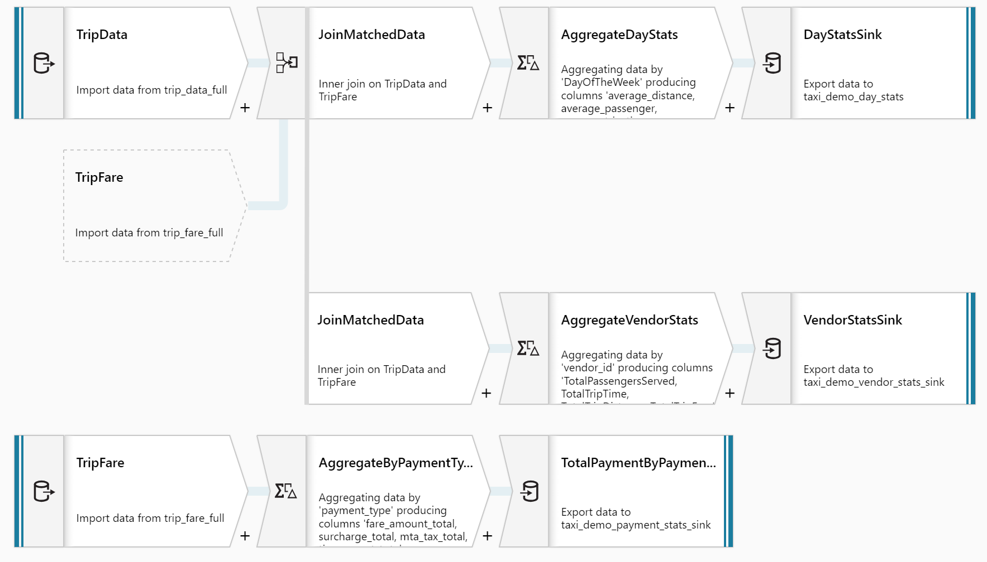
No-code data transformation at scale
Focus on building business logic and transforming data
Data cleansing, transformation, aggregation, conversion, etc.
Cloud scale via Spark execution
Resilient data flows with ease

Slide 64
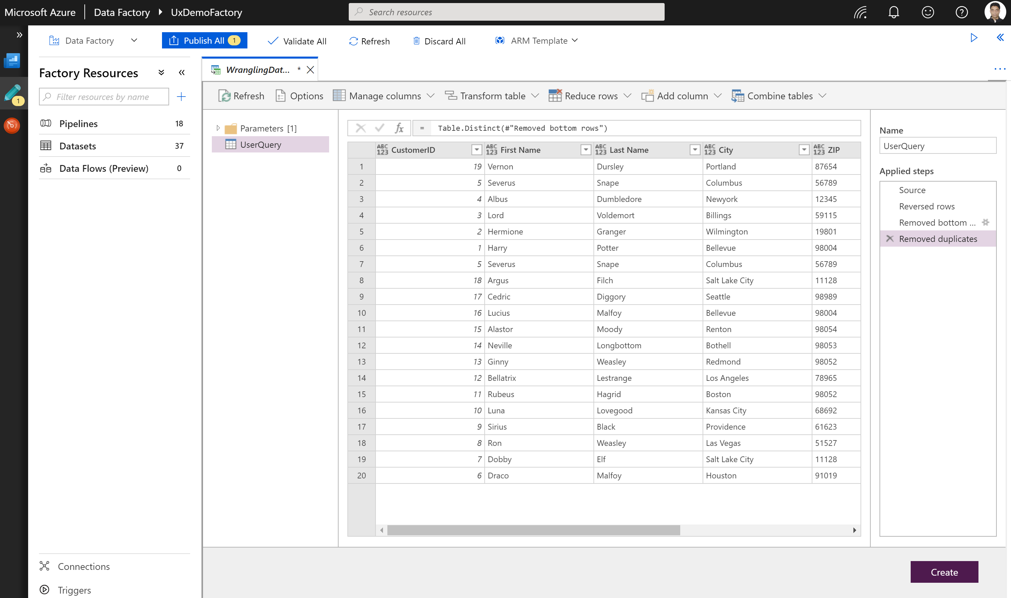
Wrangling dataflow
Code-free data preparation @scale

Slide 65
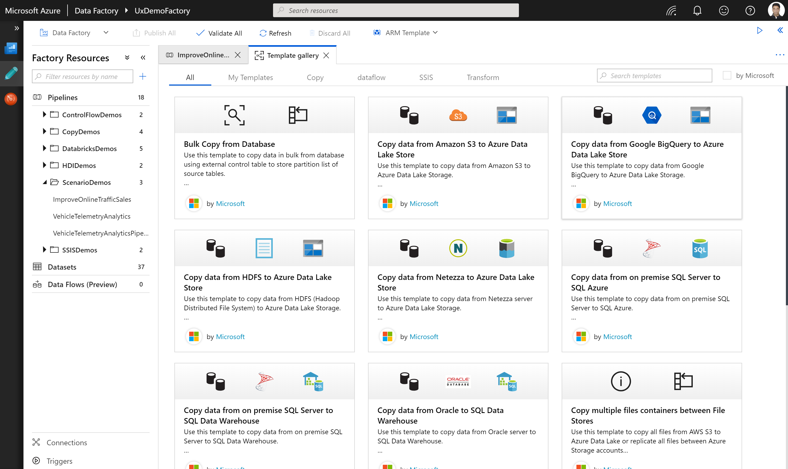
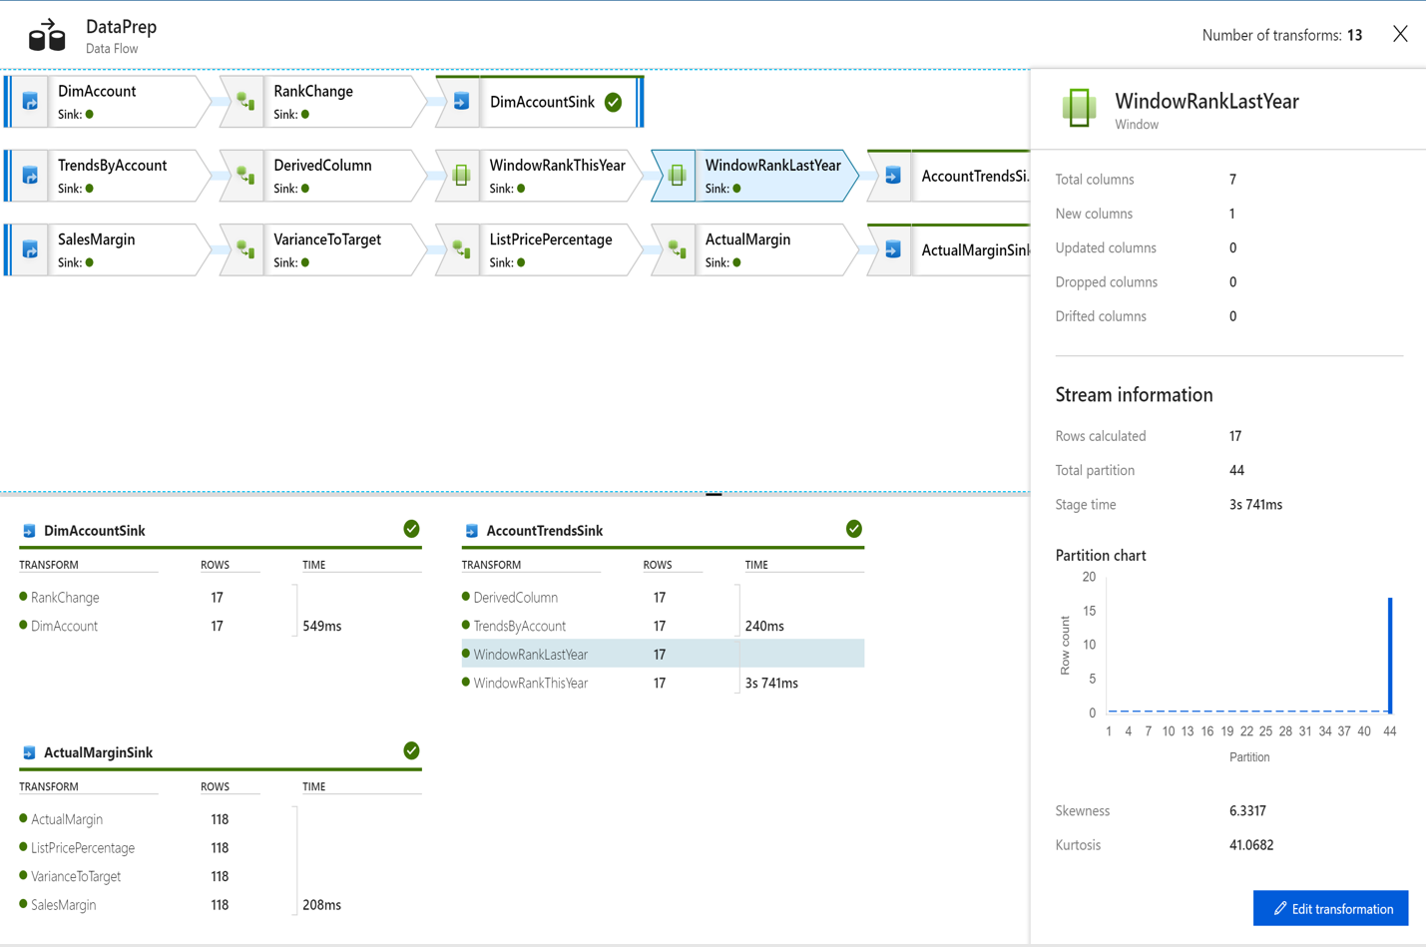
Best-in-class monitoring and management
Monitor pipeline and activity runs
Query runs with rich language
Operational lineage between parent-child pipelines
Azure Monitor Integration
Diagnostics logging
Metrics and alerts
Events
Restate pipeline and activities

Slide 66
Use templates to quickly get started
Quickly build data integration solutions
Avoid rebuilding workflows—instantiate a template
Improve developer productivity and reducing development time for repeat processes

Slide 67





Analytics for data-driven apps
INGEST
PREPARE
TRANSFORM
& ENRICH
SERVE
On-premises data
Oracle, SQL,, Teradata, fileshares, SAP
Azure
Data Factory
Azure
Data Factory
Azure
Data Factory
Cosmos DB
[SaaS] App
Browser/Device
Cloud data
Azure, AWS, GCP
Azure
Databricks
Azure
Databricks
STORE
SaaS data
Salesforce, Dynamics
Azure Data Lake Storage Gen2
Data Pipeline Orchestration & Monitoring
Azure Data Factory

Slide 68
Insights for all with Power BI + Azure Power up your BI with Azure Data Services

Slide 69






Organizations that fully harness their data outperform
AI apps & agents
Delivering airport calm with real-time analytics
$300k/day cost savings with predictive maintenance
13M personalized experiences with 33 orders/second
Notes:
Customers that overcome these challenges and fully harness the value of their data outperform:
Heathrow Airport, one of the busiest in the world, extracts insights from its massive set of constantly changing data in real-time to anticipate passenger flow and stay ahead of disruption, transforming the travel experience and making it less nerve-racking for the airport’s 200,000 daily passengers.
Rockwell automation sells oil drilling manufacturing equipment, and these drills when they go down, can cause a company 100s of thousands of dollars so they’re using AI models to predict when equipment will fail. Then they send a text or an alert to field technicians to service the equipment at the opportune time, enabling Rockwell to save $300k/day with predictive maintenance.
ASOS is one of the leading online retailers in Europe. They’ve built a personalization engine because they get 5000 new products a week, so they want to be able to get the right products to the right customers. They’ve built a recommendation engine which has driven their mobile app platform to doing 33 orders a second, growth of 25% YoY.

Slide 70
BI is more than just reporting & dashboards
Prescriptive Analytics
Algorithms
Predictive Analytics
Machine Learning
Self-Service Analytics
Interactive Data Exploration
Reporting
Dashboards

Slide 71
Customers are searching for ways to level-up their data
Dashboards
Ad-hoc Reporting
Advanced Visualization
However, their data remains…
Siloed
Under-utilized
Slow to provide insights
Notes:
To dive deeper into this scenario, we know that BI customer have been investing in answers for years. BI has become increasingly important for customers to understand their data, bring their data together, and primarily in order to gain insights into their customer base or how they can improve as a company.
This has been done by creating dashboards—focused providing an over-arching view of how sales, marketing campaigns, or other initiatives are performing.
Ad-hoc reporting when businesses need to dive into the data and find answers quickly and efficiently
Or by creating advanced visualizations to illustrate the story that data is telling and how to consume it.
However, as BI customers have continued to invst in answers for so long, their data remains siloed, under-utilized, and slow to provide the insights they need.

Slide 72
Combining BI tools and data warehouses expands analytics capabilities
Unify all your data
One source of truth
Instant insights on-the-fly
BI tools + Azure Synapse Analytics
Notes:
This is why BI customers need an industry-leading cloud data warehouse.
It allows them to:
Unify all of their data
Have one source of truth
Extract instant insights on the fly with unmatched compute power and query performance
Helping customer combine their BI tools with Azure Synapse Analytics in particular opens them up to new possibilities
Petabyte scale analytics: customers can reason and analyze over a trillion rows of data and discover insights in seconds
Insights for all: What we mean by this is that data is no longer siloed, difficult to access, or a hassle to share and collaborate on. One source of truth of where your data resides means that dashboards created in, say, Power BI pulls from all company data. And everyone, from executives to business analytits to architects can quickly get access to the insights they need that spans across their business
Advanced analytics & AI: As customers take the step from going to just reactive reporting and creating static dashboards with their BI tools to then using an industry-leading data warehouse for their one source of truth, this enables them to use that data warehouse for their serving layer of AI and to begin going from just basic reporting to real-time reporting, predictive analytics, and machine learning.
Fast, fast, fast: Data analysts, business analysts, anyone using BI tools to build important reports to disover insights shouldn’t have to be impeded by slow query performance or low concurrency. With Power BI and Synapse Analytics, complex queries that take other systems minutes to execute can be done within seconds. This is the speed that customers need to capitalize on their digital transformation rather than being met with more roadblocks as they try to deliver on the promise of insights with BI.

Slide 73

Data silos and incompatible tooling inhibit collaboration
BI tools
IT tools
Data science tools
Incompatible tooling
Siloed data
Marketing
Sales
Product
Ops
Finance
Notes:
But collaboration is extremely challenging by design, as enterprises are plagued by data silos and incompatible tooling. There’s lots of complexity when it comes to interoperating over siloed data, plus an additional layer of complexity when it comes to integration between the various tools and platforms across an organization.

Slide 74


Unify your organization
Power BI
Azure Data Services
Common Data Model on Azure Data Lake Storage
Notes:
*In presentation mode, the two boxes unite on click*
We enable you to unify your organization by helping you unify your data and your tooling.
*Click*
To unify your data, Power BI and Azure Data Services have teamed up to leverage the Common Data Model (CDM) as a standard to store and describe data, with Azure Data Lake Storage (ADLS) as the unified storage layer for all enterprise data.
The Common Data Model (CDM) is a shared data language used across Microsoft apps and services including Power BI, Dynamics 365 and Azure. Furthermore, Microsoft has joined with SAP and Adobe to form the Open Data Initiative, ensuring that the Common Data Model extends through all of the popular application stacks that enterprises use and love. Data stored in the CDM format provides semantic consistency across apps and deployments, enabling data interoperability and collaboration.
*Click*
As you would expect, the Common Data Model is natively integrated with Power BI and Azure Data Services, which also seamlessly integrate with each other. The result for your organization is unified tooling that’s natively connected to unified data.

Slide 75
Unify your organization
Power BI
Azure Data Services
Common Data Model on Azure Data Lake Storage
Notes:
*In presentation mode, the two boxes unite on click*
We enable you to unify your organization by helping you unify your data and your tooling.
*Click*
To unify your data, Power BI and Azure Data Services have teamed up to leverage the Common Data Model (CDM) as a standard to store and describe data, with Azure Data Lake Storage (ADLS) as the unified storage layer for all enterprise data.
The Common Data Model (CDM) is a shared data language used across Microsoft apps and services including Power BI, Dynamics 365 and Azure. Furthermore, Microsoft has joined with SAP and Adobe to form the Open Data Initiative, ensuring that the Common Data Model extends through all of the popular application stacks that enterprises use and love. Data stored in the CDM format provides semantic consistency across apps and deployments, enabling data interoperability and collaboration.
*Click*
As you would expect, the Common Data Model is natively integrated with Power BI and Azure Data Services, which also seamlessly integrate with each other. The result for your organization is unified tooling that’s natively connected to unified data.

Slide 76

Unleash data value with Power BI and Azure Data Services
Business value
Unmatched capabilities
Powerful visualization and reporting
Petabyte-scale
analytics
Advanced analytics and AI
Frictionless
collaboration
Business analysts
IT professionals
Data scientists
Powerful and
integrated tooling
Power BI
Azure Data Services
Unified data
Common Data Model on Azure Data Lake Storage
Notes:
By unifying your data and unifying your tooling, business analysts using Power BI can easily collaborate with IT and data scientists using Azure Data Services to unlock more value from your data than ever.

Slide 77
Maximize the value of your data
Powerful visualization and reporting
Petabyte-scale analytics
Advanced analytics and AI
Notes:
How do you fully harness your data in today’s world?
You need powerful visualization and reporting to put insights into the hands of those who need it.
In Heathrow’s case, they needed to convert all their back-end data into visual reports and dashboards that deliver aha! Insights to airport staff and employees. Say a shift in the jet stream just delayed the landing of 20 flights, putting 6,000 extra passengers in the airport at 6:00 PM, airport personnel can anticipate one to two hours beforehand so they can add extra people, buses, French fries, and other resources to support the influx.
Today, it is not uncommon for companies to have petabytes of data across the organization. You need to power your dashboards with analytics that can handle that kind of scale in order to quickly reason such massive amounts of data. Otherwise, running a query could take hours if not days.
In Rockwell’s case, they needed to reason over real-time and historical data from hundreds of sensors in their manufacturing equipment, each producing hundreds of data points every second, in order to predict points of failure. This requires massively powerful analytics and lighting fast performance over datasets that are trillions of rows long.
With the advancement of AI, opportunities to derive even deeper insights have emerged. Successful organizations today leverage AI.
In ASOS’s case, their recommendation engine is powered by machine learning models that look at a customer’s own browsing/purchase history, and that of similar customers, to intelligently recommend products that they’re more likely to buy.

Slide 78
The data warehouse + Power BI in the data-driven business
LOB sources
Azure Data Factory
Business services
Azure Synapse Analytics
Logs and streams (unstructured)
Azure Databricks
Power BI
Media (unstructured)
Files (unstructured)
Azure Data Lake Storage
Notes:
TALK TRACK: Now let’s describe how data warehouse serves a business through a simple architectural diagram.
- The modern data warehouse sits at the heart of enterprise analytics, as a source of sanctioned data, as a system of record and as a hub, serving models for reporting, business intelligence and data science

Slide 79
Leverage powerful visualization and reporting
Power BI
Visualize & report
Scale and govern efficiently
Semantic modeling
Improve management
Open-platform connectivity
Power BI
CDM folders
Azure Data Lake Storage
Notes:
Power BI and Azure Data Services unlock big data in a way that would otherwise be impossible. As previously mentioned, it is not uncommon for companies today to have petabytes of data across the organization. Analyzing and extracting insights from such massive amounts of data used to take hours, if not days.
Not so with Power BI and Azure Synapse Analytics. Using DirectQuery, you can take advantage of Azure Synapse Analytics’ industry leading performance right from Power BI, without limits on concurrency.
The new aggregations feature in Power BI boosts performance even further by caching data at the aggregated level, enabling instant response times on petabyte scale datasets with trillions of rows. If the user happens to drill down to the detailed level, Power BI will submit a DirectQuery as usual, invoking Azure Synapse Analytics’ lightning fast query performance. How fast exactly? Up to 14x times faster than other cloud providers. And it’s up to 94% cheaper too. (According to a study by Gigaom)
Together, Power BI and Azure Synapse Analytics give users the performance they need to do petabyte scale analytics.

Slide 80
Deliver petabyte-scale analytics
Power BI + Azure SQL Data Warehouse
Visualize & report
Model & serve
Power BI Aggregations
DirectQuery
14x faster and 94% cheaper
One-click connection
Power BI
Azure Synapse Analytics
CDM folders
Azure Data Lake Storage
Notes:
Power BI and Azure Data Services unlock big data in a way that would otherwise be impossible. As previously mentioned, it is not uncommon for companies today to have petabytes of data across the organization. Analyzing and extracting insights from such massive amounts of data used to take hours, if not days.
Not so with Power BI and Azure Synapse Analytics. Using DirectQuery, you can take advantage of Azure Synapse Analytics’ industry leading performance right from Power BI, without limits on concurrency.
The new aggregations feature in Power BI boosts performance even further by caching data at the aggregated level, enabling instant response times on petabyte scale datasets with trillions of rows. If the user happens to drill down to the detailed level, Power BI will submit a DirectQuery as usual, invoking Azure Synapse Analytics’ lightning fast query performance. How fast exactly? Up to 14x times faster than other cloud providers. And it’s up to 94% cheaper too. (According to a study by Gigaom)
Together, Power BI and Azure SQL DW give users the performance they need to do petabyte scale analytics.

Slide 81
Gain deep insights with advanced analytics and AI
Power BI + Azure Machine Learning
Visualize & report
Train & predict
Solve complex challenges
Reduce time-to-insight
Start with no-code ML
Extend with Azure Machine Learning
Power BI
Azure Machine Learning
CDM folders
Azure Data Lake Storage
Notes:
Finally, Power BI and Azure help organizations unlock deep insights with advanced analytics and AI. When it comes to AI, Power BI comes with automated machine learning, which allows business analysts to train commonly used ML models without writing a single line of code.
More difficult business problems that call for advanced methods require specialized data science tools. Azure Machine Learning is a platform where data scientists develop machine learning models to take on complex business challenges. Data scientists can easily use data in ADLS to train models in Azure ML, which has a load of productivity enhancing capabilities that can reduce time-to-insight from weeks to hours.
Azure ML models built by data scientists can be easily shared with business analysts. Power BI works behind the scenes to discover the models to which each user has access and automatically creates a point and click user interface to invoke them. This makes collaboration among business analysts and data scientists easier and faster than ever before.

Slide 82






Enterprise BI in Power BI
Semantic modeling
Governance
Scalability
Open-platform connectivity
Application lifecycle management
Manageability
Notes:
Christian
DATA PROTECTION
Classify and label Power BI artefacts
Oversight for administrators on sensitive data being used in Power BI and data protection incidents that occurred
Integration with Microsoft Cloud App Security for auditing across the Microsoft Office ecosystem including Power BI artefacts

Slide 83
Break

Slide 84
Lab 1: Modern Data Warehouse Delivering the Modern Data Warehouse with Azure Synapse Analytics, Azure Databricks, and Power BI
Notes:
Step 1: Go to Instructor-led Labs: https://www.microsoft.com/handsonlabs/instructorledlabs/
Step 2: Sign in
Step 3: Search for Delivering the Modern Data Warehouse with Azure Synapse Analytics, Azure Databricks, and Power BI
Step 4: Select Schedule Lab
Step 5: Enter Lab Information
*Note: This lab is based on this GitHub Repo: https://github.com/solliancenet/tech-immersion-data-ai/tree/master/data-exp6
*Note: Schedule this lab at 7-10 days before delivering this workshop so you can ensure it is provisioned and all seats are ready for attendees.

Slide 85
Lab 2: Deep Dive on Azure Synapse Analytics The heart of the modern data warehouse
Notes:
Step 1: Go to Instructor-led Labs: https://www.microsoft.com/handsonlabs/instructorledlabs/
Step 2: Sign in
Step 3: Search for Modern Data Warehouse
Step 4: Select Schedule Lab
Step 5: Enter Lab Information
Step 6: Focus only on the Azure Synapse Analytics sections in this lab
*Note: Schedule this lab at 7-10 days before delivering this workshop so you can ensure it is provisioned and all seats are ready for attendees.

Slide 86
Get Started
Get in touch with us: https://info.microsoft.com/ww-landing-azure-sql-data-warehouse-contactme.html
Attend a hands-on Azure Analytics workshop with Informatica: https://now.informatica.com/Microsoft_CDW_Workshops.html#fbid=uqwtl_SXNFV
Create a free Azure account and get started with Azure Synapse Analytics: https://azure.microsoft.com/free/sql-data-warehouse/
Notes:
CTA 1: Get in touch with us: https://info.microsoft.com/ww-landing-azure-sql-data-warehouse-contactme.html
CTA 2: Attend a hands-on Azure Analytics workshop with Informatica: https://now.informatica.com/Microsoft_CDW_Workshops.html#fbid=uqwtl_SXNFV
CTA 3: Create a free Azure account and get started with SQL Data Warehouse: https://azure.microsoft.com/free/sql-data-warehouse/

Slide 88
The data warehouse in the data-driven business
LOB sources
Azure Data Factory
Business services
Azure Synapse Analytics
Logs and streams (unstructured)
Azure Databricks
Power BI
Media (unstructured)
Files (unstructured)
Azure Data Lake Storage
Notes:
TALK TRACK: Now let’s describe how data warehouse serves a business through a simple architectural diagram.
- The modern data warehouse sits at the heart of enterprise analytics, as a source of sanctioned data, as a system of record and as a hub, serving models for reporting, business intelligence and data science

Slide 89


Azure Synapse Analytics
Azure Synapse Analytics
Limitless analytics service with unmatched time to insight
Unified experience
Synapse Studio
On-premises data
Integration
Management
Monitoring
Security
Azure Machine Learning
Cloud data
Analytics Runtimes
SQL
Power BI
SaaS data
Azure Data Lake Storage
Notes:
Now, let’s go deeper into the new features available in Azure Synapse.
Truly, I’m excited what this announcement means for the world of data. We have taken our industry leading data warehouse to a whole new level of performance and capabilities.
Azure Synapse provides a single analytics service that integrates the management, security, and monitoring of data into an easy-to-use, unified environment.
This includes a built-in data integration layer so that data engineers can use a code-free visual environment for managing data pipelines in the same service that DBAs use to optimize query performance
On top of this, we’ve natively integrated a big data engine for big data processing and machine learning to the most powerful data warehousing engine—bringing these two worlds together so that businesses aren’t forced to choose between managing a data lake or a data warehouse
These can both be consumed using our traditional model of provisioned compute, as well as our new serverless on-demand mode where you can use T-SQL to query data directly from the lake, in your data warehousing environment, at petabyte-scale
And, as you can see, Azure Synapse is deeply integrated with Power BI so that there is truly end-to-end analytics in a single service—imagine how this will help data professionals accelerate time-to-insight and accomplish more
And all of this comes together in a unified experience in the Azure Synapse studio—a unified workspace to build end-to-end analytics solutions.
I’m excited to see what you go and build with Azure Synapse!
Now, let’s jump into our last announcement.
[click]

